Slide 1
Optimization of Cell Tower Distribution for Extending Drone Coverage
Ismet Celik (10472265)
Namadev Narne (10457631)
Rituraj Gaikawad(10455838)

Slide 2
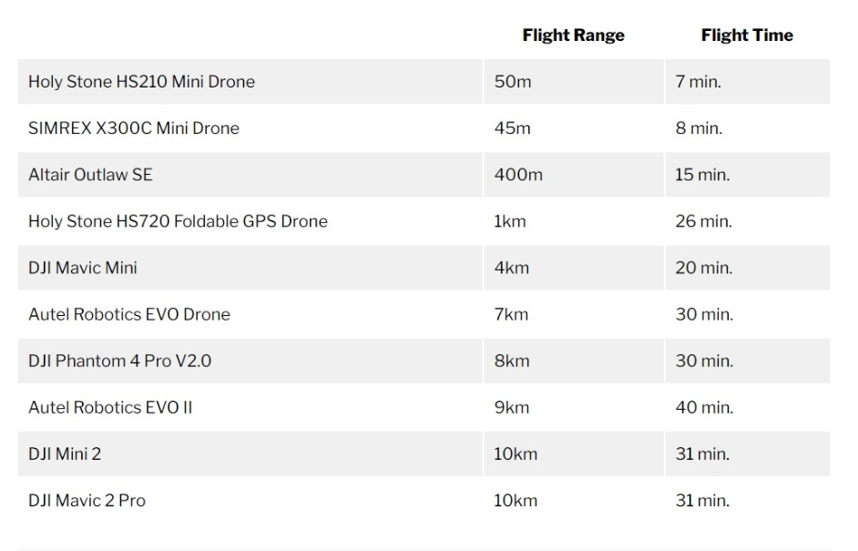
Problem Description
Currently drones have a flight range of 50 meters to 10 kilometres (about the cruising altitude of a commercial jet) without considering various factors such as obstacles, payload, weather and frequency interference.
Cell Towers could be placed to cover the Manhattan area to increase the flight range of the drones.
With a strong signal from the towers, drones will be able to extend their flight range and deliver more packages.
Improving the range of the cell tower can be further used for crime detection and surveillance over a larger population of people.

Slide 3
Problem Significance
Drones might use by major security forces (NYPD) for crime detection and surveillance over the major cities.
Many companies such as Amazon, UPS etc. are considering to deliver packages by using drones in near future.

Slide 4
Innovation
In this approach we build a network of towers by choosing their locations and numbers over Manhattan. These towers will be used for covering maximum population. In order to achieve that, we will use MIXED-INTEGER LINEAR PROGRAMING model to choose locations to build cell towers.

Slide 5
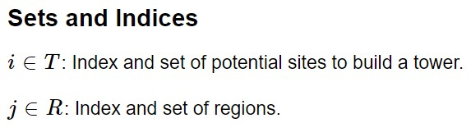
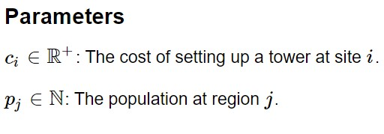
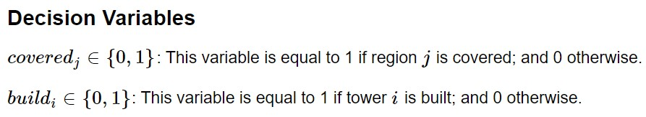
Optimization Model

Slide 6
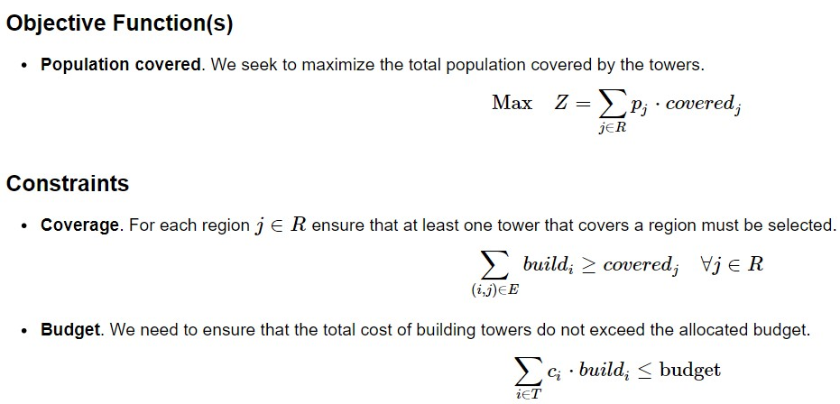
Optimization Model

Slide 7
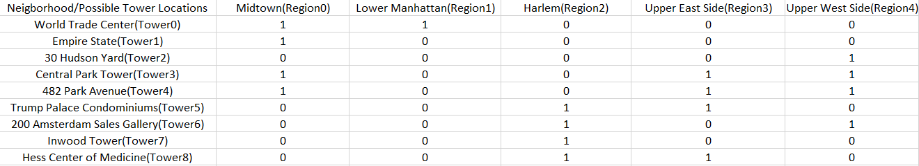
Implementation
Extracted the neighborhoods and the population of Manhattan from [2]
Budgets for building the towers are assumed.
Population and possible Tower location to cover the neighborhoods is as follows:

Slide 8
Risk
As from the result obtained from Algorithm three towers gives us the total coverage of the people.
When one of the tower malfunctions the entire the operation is disrupted as there are no backup options.
This will have a great effect on the efficiency of the entire system.

Slide 9

Conclusion
With this Model our Algorithm maximize the covered population and location to build the tower along with budget consideration.
We implemented our algorithm with budgets $5M, $10M, $15M and assumed the cost of $5M to construct a single tower, you can see our outputs in the pictures attached below and in the next slides.
Iteration 1:

Slide 10
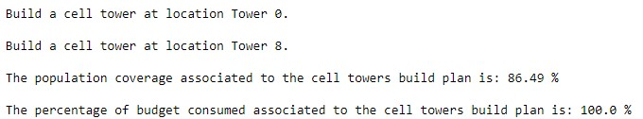
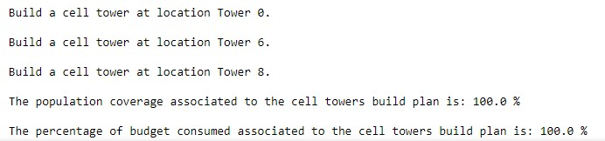
Conclusion (contd.)
Iteration 2:
Iteration 3(final output):

Slide 11
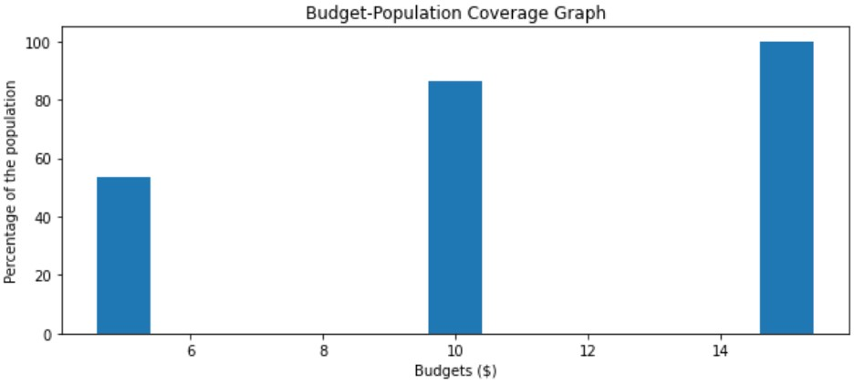
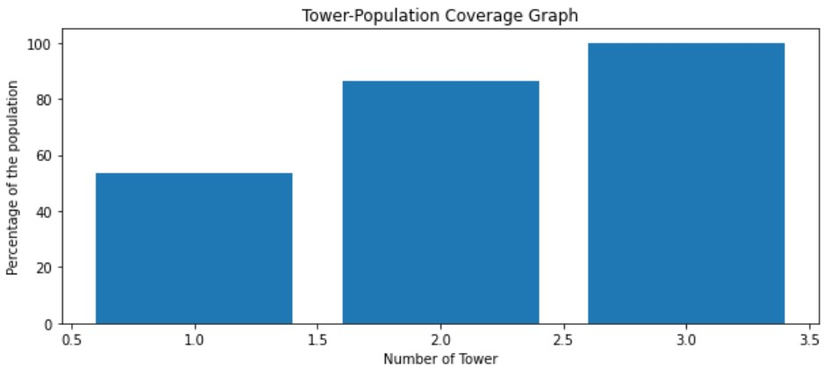
Results
Graph of Budget vs Percentage of Population covered:
Graph of Number of Towers vs Percentage of Population covered:

Slide 12
Future Work
In our model we assumed the budget to construct a tower at a location, with increase in the budget backup towers can be designed to the faulty ones.
The proposed model can be developed using Real-Time data from various Wireless Companies for designing and using the towers.
Further Improvements can be done by incorporating more constraints associated in the Drone operation such as the permeability of the materials of the building, weather conditions, etc.

Slide 13
Collabration
ZOOM meetings and conference calls were thoroughly used for communication and collaboration between the group members.
Google Slides was used to create the presentation.

Slide 14
References
[1] “Cell Tower Coverage.” cell_tower, Gurobi Optimization, gurobi.github.io/modeling- examples/cell_tower_coverage/cell_tower.html.
[2]“Manhattan Neighborhoods by Population.” WorldAtlas, WorldAtlas, worldatlas.com/articles/manhattan-neighborhoods-by-population.html
[3] “ChargeUp.” GitHub, Ccubc, https://github.com/ccubc/ChargeUp

